Slide 1

КАК ОПТИМИЗИРОВАТЬ ЦЕНУ ПРОДУКТА
HEAD OF CVM @ MAGNIT SELEZNEV A.A.

Slide 2

В КАЧЕСТВЕ ВСТУПЛЕНИЯ

Slide 3




@SeleznevArtem
/seleznev.artem.info
/nameartem
HEAD OF CVM @ MAGNIT SELEZNEV A.A.

Slide 4
@SeleznevArtem
/seleznev.artem.info
/nameartem
HEAD OF CVM @ MAGNIT SELEZNEV A.A.

Slide 5
МЫ ТОЧНО НЕ ПОГОВОРИМ О…
 | f1 | f2 | f3 | f4 | f5 | fN
1 | … | … | … | … | … | …
2 | … | … | … | … | … | …
3 | … | … | … | … | … | …
… | … | … | … | … | … | …
N | … | … | … | … | … | …

Slide 6
МЫ ТОЧНО НЕ ПОГОВОРИМ О…
 | f1 | f2 | f3 | f4 | f5 | fN
1 | … | … | … | … | … | …
2 | … | … | … | … | … | …
3 | … | … | … | … | … | …
… | … | … | … | … | … | …
N | … | … | … | … | … | …
TARGET
…
…
…
…
…

Slide 7

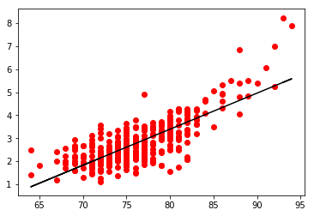
МЫ ТОЧНО НЕ ПОГОВОРИМ О…
 | f1 | f2 | f3 | f4 | f5 | fN
1 | … | … | … | … | … | …
2 | … | … | … | … | … | …
3 | … | … | … | … | … | …
… | … | … | … | … | … | …
N | … | … | … | … | … | …
TARGET
…
…
…
…
…

Slide 8

«ОДНА ЗАДАЧА ДАТА АНАЛИТИКА»

Slide 9
ОПТИМИЗАЦИЯ ЦЕНЫ?
Когда появилась данная задача? _________

Slide 10
ОПТИМИЗАЦИЯ ЦЕНЫ?
Когда появилась данная задача? В 1980х

Slide 11
ОПТИМИЗАЦИЯ ЦЕНЫ?
Промо
Реклама
Revenue management Yield management
1980х

Slide 12

ОПТИМИЗАЦИЯ ЦЕНЫ?
Промо
Реклама
Revenue management Yield management
1980х

Slide 13

«ОДНА ЗАДАЧА ДАТА АНАЛИТИКА»
Задача

Slide 14

«ОДНА ЗАДАЧА ДАТА АНАЛИТИКА»
Задача

Slide 15

«ОДНА ЗАДАЧА ДАТА АНАЛИТИКА»
Задача

Slide 16
«ОДНА ЗАДАЧА ДАТА АНАЛИТИКА»
Задача

Slide 17
«ОДНА ЗАДАЧА ДАТА АНАЛИТИКА»
АНАЛИТИЧЕСКИЙ КАЛЬКУЛЯТОР
Цель «П»
500 руб
-15%
Цена
-30%
2 по 1
Данные «О»
Продажи

Slide 18

ЦЕНА И ЕЁ ЦЕННОСТЬ

Slide 19

ЦЕНА ПРОДУКТА

Slide 20
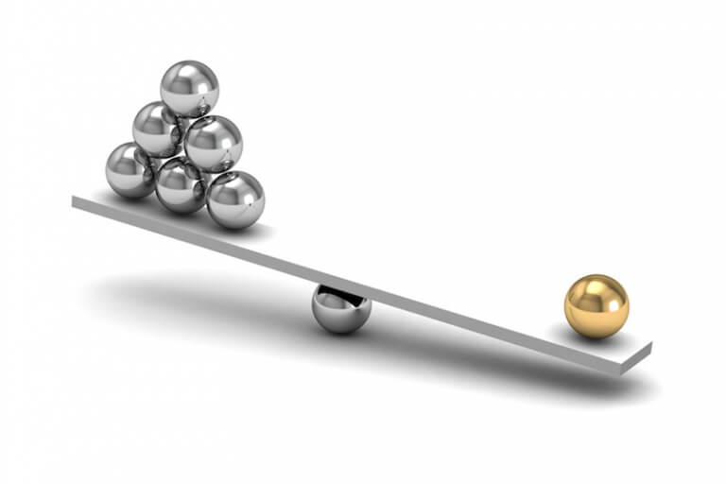


ЦЕНА ПРОДУКТА

Slide 21
ЦЕНА ПРОДУКТА
Сегменты покупателей Гео Сезонность и т.п.

Slide 22

ЦЕНА ПРОДУКТА

Slide 23
ЦЕНА ПРОДУКТА
Количество товара

Slide 24
ЦЕНА ПРОДУКТА
Количество товара
Зависимые продукты
«Переключатели»

Slide 25
ЦЕНА ПРОДУКТА
Количество товара
Зависимые продукты
«Переключатели»
Цели компании

Slide 26
ЦЕНА ПРОДУКТА
 | Факт | `+1% Q | `+1% P | `+1% V | `+1% C
Кол-во | 1000 | 1010 | 1000 | 1000 | 1000
Цена | 30 | 30 | 30,3 | 30 | 30
Закупочная цена | 25 | 25 | 25 | 25,25 | 25
Фиксированные затраты | 4000 | 4000 | 4000 | 4000 | 4040
Доход | 1000 | 1050 | 1300 | 750 | 960
% Дохода |  | 5% | 30% | -25% | -4%

Slide 27
ЦЕНА ПРОДУКТА
 | Факт | `+1% Q | `+1% P | `-1% V | `-1% C
Кол-во | 1000 | 1010 | 1000 | 1000 | 1000
Цена | 30 | 30 | 30,3 | 30 | 30
Закупочная цена | 25 | 25 | 25 | 24,75 | 25
Фиксированные затраты | 4000 | 4000 | 4000 | 4000 | 3960
Доход | 1000 | 1050 | 1300 | 1250 | 1040
% Дохода |  | 5% | 30% | 25% | 4%

Slide 28

ЦЕНА И ЕЁ ГРАНИЦЫ

Slide 29
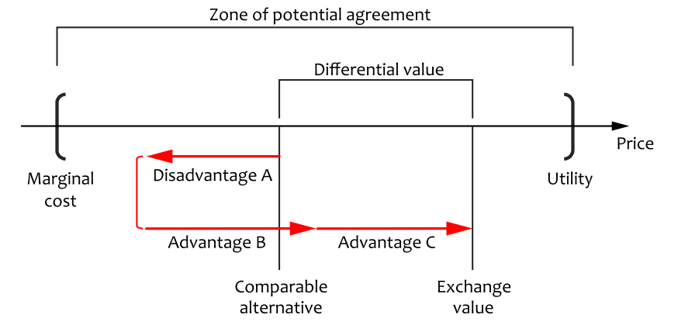
ГРАНИЦЫ ЦЕНЫ
Согласие на покупку
Цена

Slide 30
ГРАНИЦЫ ЦЕНЫ
Согласие на покупку
Цена
Цена без маржи
Максимальная цена

Slide 31
ГРАНИЦЫ ЦЕНЫ
Согласие на покупку
Цена
Минусы продукта
Цена без маржи
Максимальная цена
Плюсы продукта

Slide 32
ГРАНИЦЫ ЦЕНЫ
Согласие на покупку
Цена
Минусы продукта
Цена без маржи
Максимальная цена
Плюсы продукта (2)
1
2

Slide 33
ГРАНИЦЫ ЦЕНЫ
Согласие на покупку
Возможная цена
Цена
Минусы продукта
Цена без маржи
Максимальная цена
Плюсы продукта (2)
1
2

Slide 34
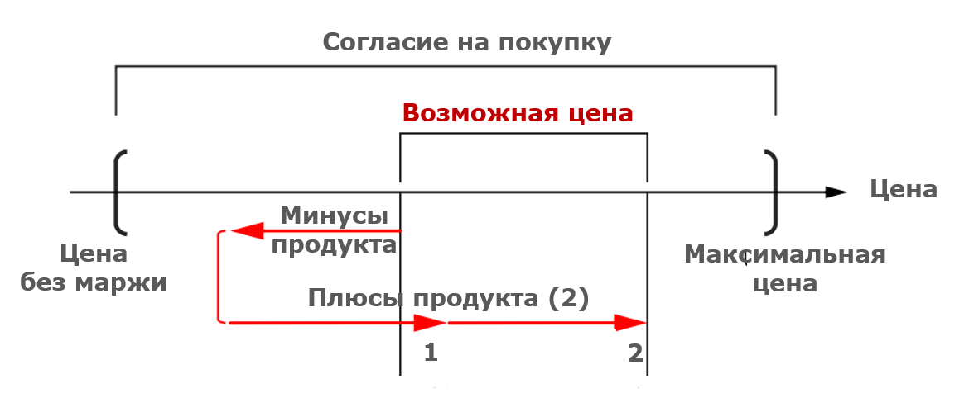
АНАЛИЗ СОЧЕТАНИЙ
ConJoin (Python)

Slide 35
ОСОЗНАННОСТЬ ЦЕНЫ

Slide 36
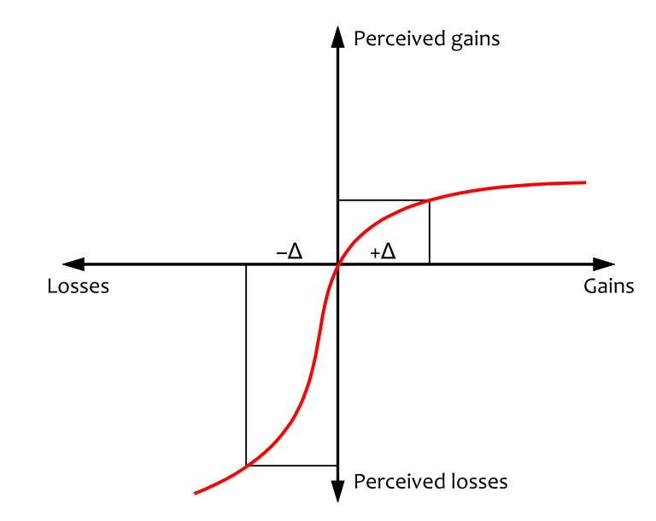
Предполагаемый Доход
Потери
Доход
Предполагаемые Потери

Slide 37
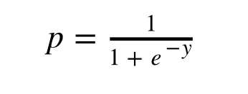
Предполагаемый Доход
Потери
Доход
Предполагаемые Потери

Slide 38
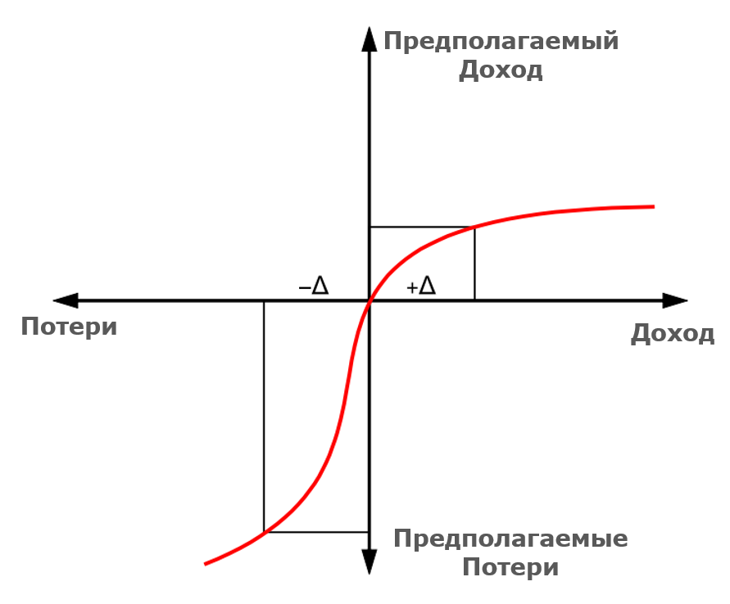
ГОТОВНОСТЬ ЗАПЛАТИТЬ ЗА ТОВАР?

Slide 39
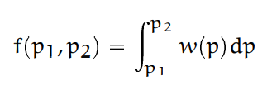

ГОТОВНОСТЬ ЗАПЛАТИТЬ ЗА ТОВАР?

Slide 40
ГОТОВНОСТЬ ЗАПЛАТИТЬ ЗА ТОВАР?
WTP (Python)

Slide 41

ЦЕНА И ЗАВИСИМОСТИ

Slide 42
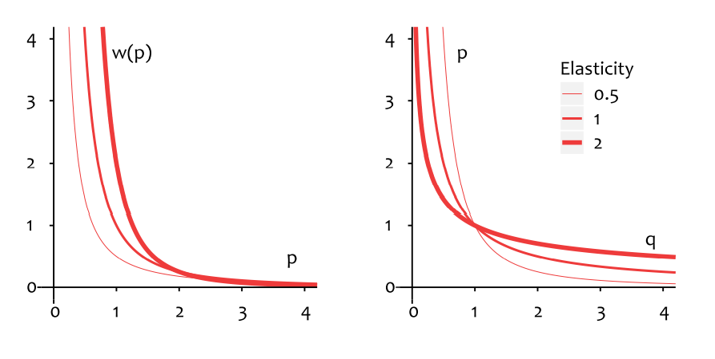

ЭЛАСТИЧНОСТЬ

Slide 43
ЭЛАСТИЧНОСТЬ
Elasticity (Python)

Slide 44
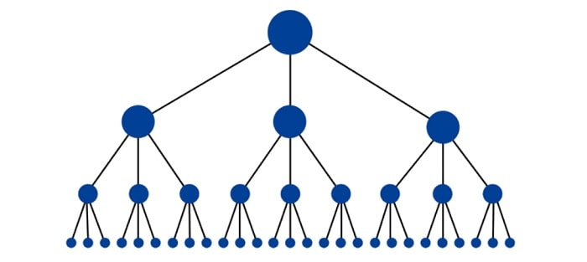
БАЗОВАЯ СТРУКТУРА ЦЕНЫ

Slide 45
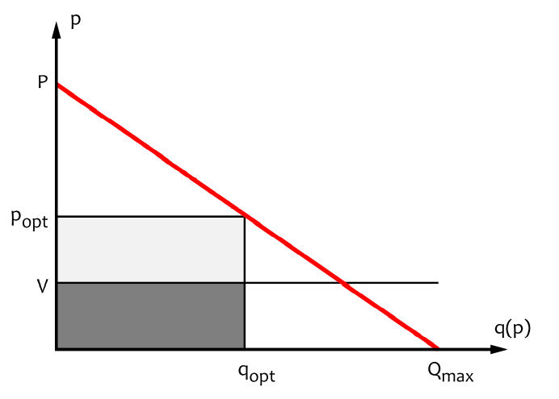
ИНДИВИДУАЛЬНАЯ ЦЕНА

Slide 46

ИНДИВИДУАЛЬНАЯ ЦЕНА

Slide 47
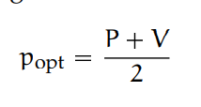
ИНДИВИДУАЛЬНАЯ ЦЕНА

Slide 48

ИНДИВИДУАЛЬНАЯ ЦЕНА

Slide 49
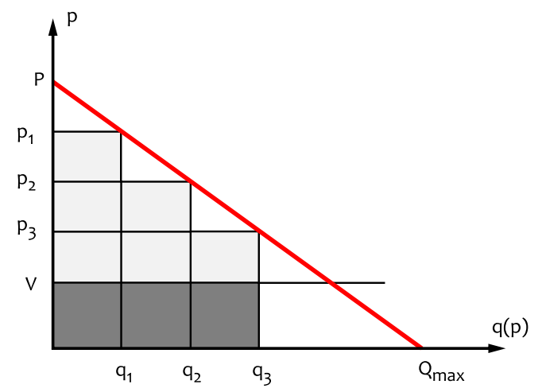
ИНДИВИДУАЛЬНАЯ ЦЕНА

Slide 50
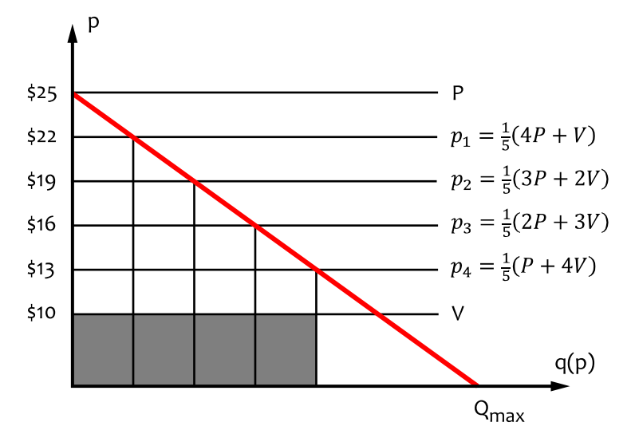
ИНДИВИДУАЛЬНАЯ ЦЕНА

Slide 51
ИНДИВИДУАЛЬНАЯ ЦЕНА
E | 1,05 | 1,1 | 1,3 | 1,5 | 1,7 | 1,9
P | 10 | 10 | 10 | 10 | 10 | 10
OP | 210 | 110 | 43,33 | 30 | 24,29 | 21,11

Slide 52
ИНДИВИДУАЛЬНАЯ ЦЕНА
E | 1,05 | 1,1 | 1,3 | 1,5 | 1,7 | 1,9
P | 10 | 10 | 10 | 10 | 10 | 10
OP | 210 | 110 | 43,33 | 30 | 24,29 | 21,11

Slide 53

ОПТИМИЗАЦИЯ

Slide 54
ОПТИМИЗАЦИЯ ЦЕНЫ
Оптимизация (Python)

Slide 55
ИТОГИ

Slide 56
И ТАК КАЖДЫЙ ДЕНЬ
Узнали
Узнать
Состав цены
Каннибализация
Границы цены
Ценообразование набора
WTP
Эконометрика
Эластичность
Сегментация
Расчет индивидуальной цены
И многое другое …

Slide 57
КАК ОПТИМИЗИРОВАТЬ ЦЕНУ ПРОДУКТА
HEAD OF CVM @ MAGNIT SELEZNEV A.A.
@SeleznevArtem
/seleznev.artem.info
/nameartem

Slide 58
Оптимизация цены

Slide 59

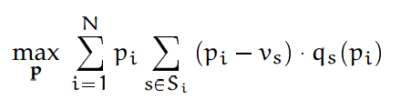
A demand model enables us to search for the optimal price by analyzing how the price changes increase or decrease the profits. We have already seen that this optimization is not particularly difficult for basic price structures and an oversimplified environment that does not account for the special properties of supply, demand, and operations that can be found in real applications. In practice, however, we face numerous constraints and interdependencies that require much more elaborate and specialized optimization models to be developed.
The goal of price differentiation, more commonly referred to in economic texts as price discrimination, is to find the optimal prices for separate customer segments or individual customers. Price optimization at the segment or customer level requires the creation of a demand model that takes customer or segment properties as parameters or the creation of a separate demand model for each segment. This can be achieved with the demand prediction methods that we have previously discussed.

Slide 60
Отработанные

Slide 61
Первое упоминание The opportunity to automatically improve tactical price decisions was first recognized and seized by the airline industry at the beginning of the 1980s and can be partially attributed to the advancement of digital reservation systems that enabled dynamic and agile resource and price management.
Создание новых профессии This new, truly algorithmic, approach, commonly referred to as revenue management or yield management
Применяется для promotions and advertisements. Price management methods can be used both to optimize discount values of promotions and to price advertising and media resources sold to service clients

Slide 62

One notable example is stock level constraint – if a seller has a limited stock of a product, the quantity sold Q is the minimum of the demand and the stock level. – Another important factor is dependent demands – because products in one category are often substitutable, a change in the price of one product can make customers switch to another product. This makes the optimization problem more complex because product prices have to be optimized jointly, not individually Finally, a seller can pursue additional goals that translate into additional constraints. For example, a fashion retailer can aim at selling out the inventory by the end of the season.
Цена может быть сложена из более сложных варианто
or many dimensions, such as customer segments, store locations, seasons, classes of service, and so forth
The demand is a function of price and other variables that range from competitor prices to weather. In the most basic case, the revenue management system can optimize prices

Slide 63
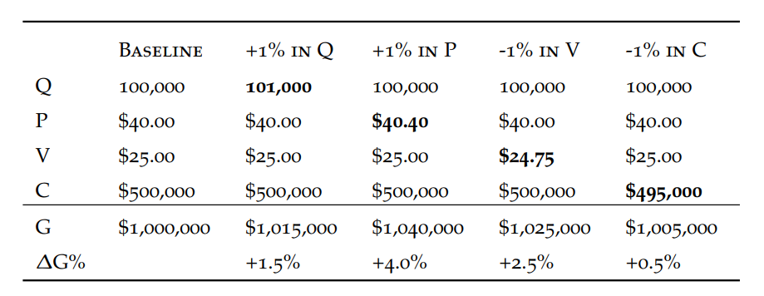
One of the reasons is that the price determines how the product or service is positioned on the market and perceived by customer
For example, a study by McKinsey and Associates analyzes the profits of 2,463 companies and comes to the conclusion that a 1% change in price results in 11.1% profit improvement, whereas a 1% improvement in sales volume, variable cost, or fixed costs yields improvements of 3.3%, 7.8%, and 2.3%, respectiv

Slide 64
Economic theory argues that price is determined by the interplay of supply and demand on the market. Although every product or service has its production cost, which can sometimes be considered as a “fair” baseline for the price, pricing requires us to delve into the valuation logic of both the seller and the buyer

Slide 65
point of reference The potential gains and losses associated with a deal are evaluated by comparison with some point of reference. The point of reference is based on past experience (e.g., the last observed price for a given or similar product) or judgement and tends to be persistent once it is set. diminishing sensitivity Changes in gains or losses are sharply perceived in the zone around the reference point but become less noticeable as the magnitudes of gain or loss increase. The difference between $9 and $19 discounts appears to be substantial, but the same ten dollar difference is not perceived equally valuable for discounts of $719 and $729. loss aversion Losses are generally perceived more sharply than gains of the same magnitude. A loss of $100 is typically perceived more important than a gain of $100. risk aversion for gains Guaranteed gains are preferred to opportunistic gains of the same magnitude. A prospect who has the choice of getting a guaranteed $450 or of winning $1000 with a 50% chance (and a 50% chance of winning nothing) generally prefers the first option. risk seeking for losses In contrast to gains, potential losses are preferred to guaranteed losses. A prospect who has the choice of definitely losing $450 or of losing $1000 with a 50% chance (and a 50% chance of losing nothing) generally prefers the second alternative.
Willegnes to pay расчет
https://github.com/jbonfardeci/conjoint-analysis

Slide 66
Utility, value exchange models, and other valuation methods help us to predict the expected willingness to pay for a given product
The demand function can be viewed not only as an aggregate market metric determined by variance of willingness to pay but also as a model of a single customer behavior, in the sense that a given consumer might be willing to buy different quantities of product at different prices. In the latter case, willingness to pay should be considered as willingness to pay per unit

